Slide 2
Top 10 Azure Security Best Practices
Mark Simos
Lead Cybersecurity Architect

Slide 3
Attack services are cheap
More details at https://aka.ms/CISOWorkshop
Exploit kits:
Price: $1,400 per month
Highest average price
Zero-days:
Price: $5,000 to $350,000
Ransomware:
Price: $66 upfront or
30% of the profit (affiliate model)
Loads (compromised device):
Price: PC - $0.13 to $0.89
Mobile - $0.82 to $2.78
Attackers
Spearphishing services:
Price: $100 to $1,000 per successful account take over
Compromised accounts:
Price: $150 for 400M Averages $0.97 per 1,000
Breaching services on a per job basis:
Price range: $250 or much more
Denial of Service:
Price: $766.67 per month

Slide 4
Attack services are cheap
More details at https://aka.ms/CISOWorkshop
Zero-days:
Price: $5,000 to $350,000
Exploit kits:
Price: $1,400 per month
FOCUS ON HYGIENE (NOT ZERO DAYS)
Zero day vulnerabilities are expensive and impractical for many attacks. https://aka.ms/CyberHygiene has guidance from Microsoft + NIST, the Center for Internet Security (CIS), and US DHS NCCIC (formerly US-CERT)
Ransomware:
Price: $66 upfront or
30% of the profit (affiliate model)
Loads (compromised device):
Price: PC - $0.13 to $0.89
Mobile - $0.82 to $2.78
Spearphishing services:
Price: $100 to $1,000 per successful account take over
FOCUS ON MFA/PASSWORDLESS & ZERO TRUST
Attackers have moved to Identity attacks like phishing and cred theft (which easily evade traditional network defenses)
Increase cost of these attacks starting with administrative privileges and other business critical assets
Attackers
Compromised accounts:
Price: $150 for 400M Averages $0.97 per 1,000
Denial of Service:
Price: $766.67 per month
Breaching services on a per job basis:
Price range: $250 or much more
ENABLE DDoS PROTECTION FOR CRITICAL SERVICES
Ensure that your business-critical services have DDoS protection from Azure platform or a capable 3rd parties

Slide 5

Agenda
Introduction:
Azure Security Compass
Secure Score
Top 10 Best practices
Calls to Action
Follow Best Practices
Learn More
Share
Provide Feedback

Slide 6
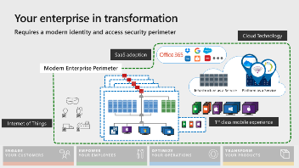
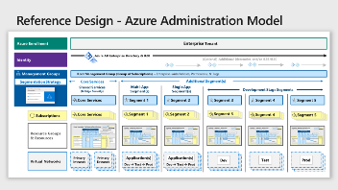
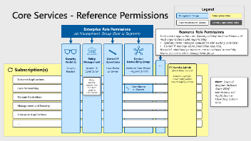
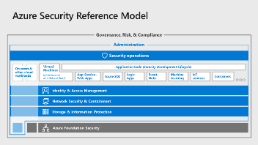
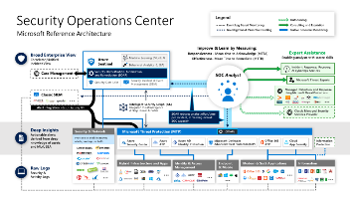
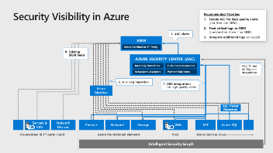
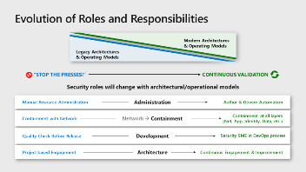
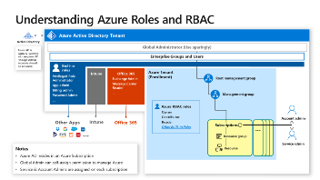
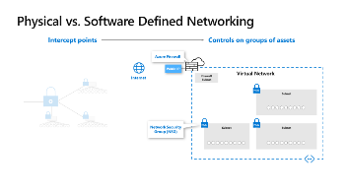
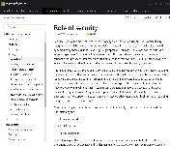
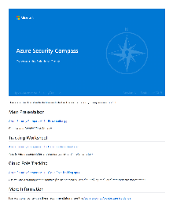
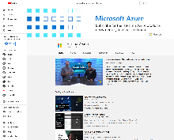
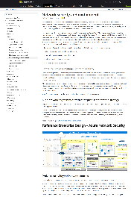
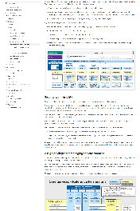
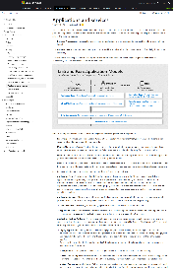
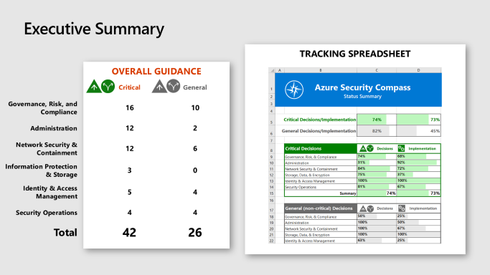
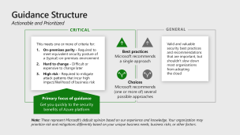
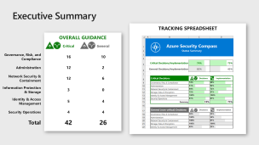
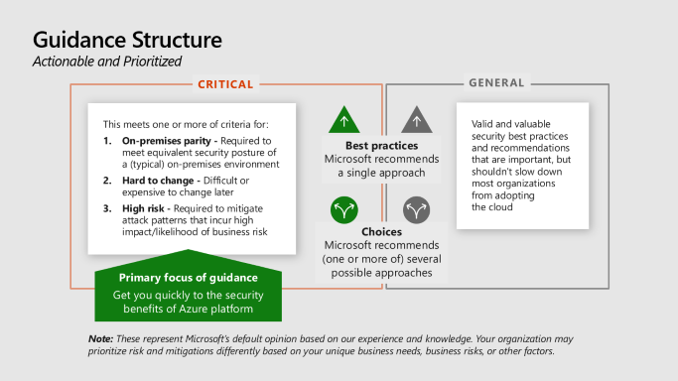
What is Azure Security compass?
Azure Security Guidance
Strategy Transformation Guidance
Changes from On-premises Security
Reference Models / Diagrams
Actionable Best Practices (Top 10 is a subset)
Extensive Visualizations
Architecture Documentation aka.ms/AzureSecurityArchitecture
Download Site aka.ms/AzureSecurityCompass
Slides –
Tracking Spreadsheets
And more…
Videos aka.ms/AzureSecurityCompass-Videos
COMING SOON

Slide 7

Guidance Structure Actionable and Prioritized
Critical
General
This meets one or more of criteria for:
On-premises parity - Required to meet equivalent security posture of a (typical) on-premises environment
Hard to change - Difficult or expensive to change later
High risk - Required to mitigate attack patterns that incur high impact/likelihood of business risk
Valid and valuable security best practices and recommendations that are important, but shouldn’t slow down most organizations from adopting the cloud
Best practices
Microsoft recommends a single approach
Choices
Microsoft recommends (one or more of) several possible approaches
Primary focus of guidance
Get you quickly to the security benefits of Azure platform
Note: These represent Microsoft’s default opinion based on our experience and knowledge. Your organization may prioritize risk and mitigations differently based on your unique business needs, business risks, or other factors.
Notes:
Key Takeaway: This guidance is structured to provide clear guidance to help simplify your Azure Security decisions
Guidance Type
Best Practices – represent areas with a single recommended approach
Choices – represent areas where one or more approaches are valid
Prioritization (Critical vs. General) – This designation helps organizations prioritize which security measures to focus on first:
Organizations new to the cloud, we have found this helps with identifying which security measures are urgent as they move to the cloud vs. those that can be deferred until after migration is underway.
Organizations are already operating on Azure can use this as a prioritization for how to improve their security posture.

Slide 8
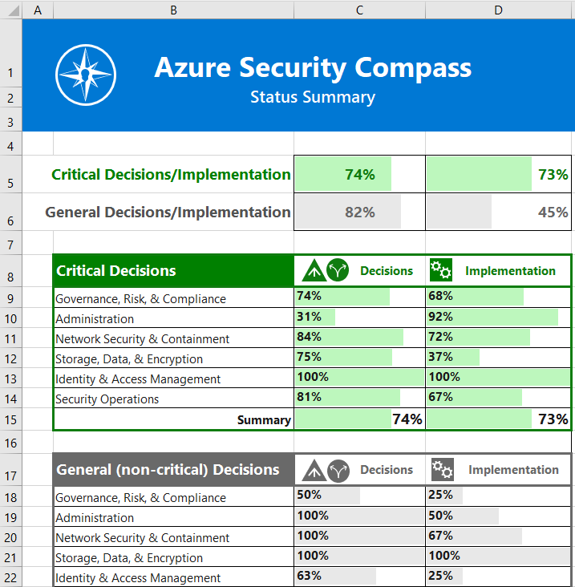
Executive Summary
Tracking Spreadsheet
Overall Guidance
 |  | Critical | General
Governance, Risk, and Compliance |  | 16 | 10
Administration |  | 12 | 2
Network Security & Containment |  | 12 | 6
Information Protection & Storage |  | 3 | 0
Identity & Access Management |  | 5 | 4
Security Operations |  | 4 | 4
Total |  | 42 | 26
Notes:
Key Takeaway: This guidance also includes a tracking spreadsheet to help track the decisions
This can be used by an organization to track status for Microsoft’s recommendations.

Slide 9

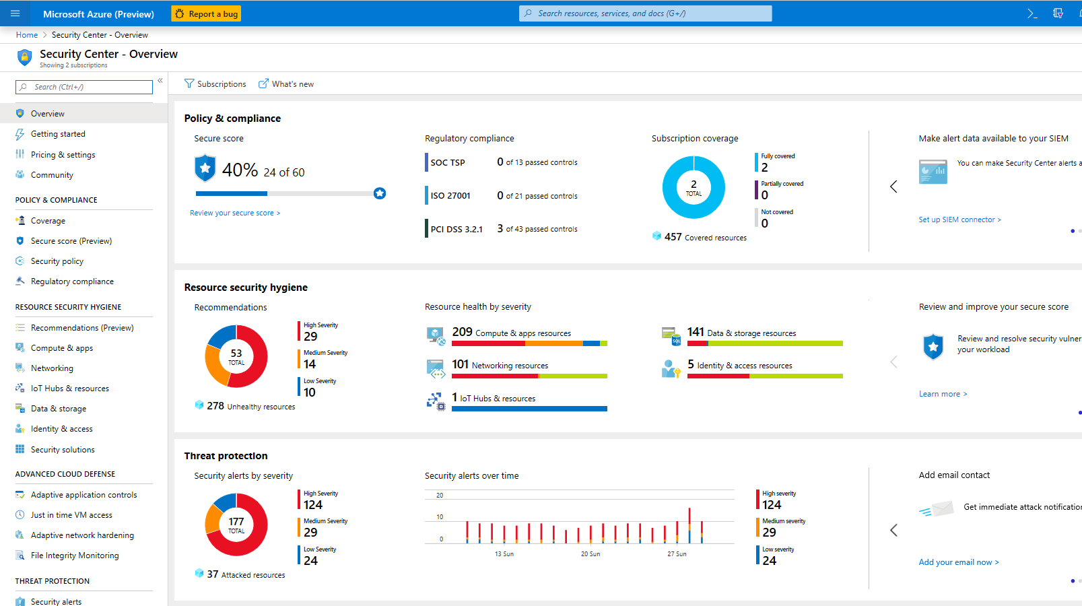
Visibility Across Your Estate with Secure Score
NEW (Private Preview) – Percentage based reporting for easier tracking/benchmarking
NEW (Private Preview) – Recommendation Grouping for Clarity (attack vectors/security controls)
Notes:
1. Context Setting
This is a quick review of Secure Score capability (5-10 minutes)
This is the new Secure Score interface – you can sign up now (link at end) or wait a few weeks
Secure Score and Azure Security Compass are complementary (and we are continuing to iterate to make into a more seamless experience)
Azure Security Compass – Broad strategic/architectural design decisions
e.g. How do I intentionally build security plan/strategy?
Azure Security Center (ASC) monitors a subset of these
e.g. How do I monitor detect vulnerabilities and threats?
Secure Score is measurement mechanism in ASC
e.g. How am I doing against Microsoft’s recommendations do I monitor detect vulnerabilities and threats?
2. Show Secure Score
Show Scoring (noting changes) and different categories and highlight a few items
Presage that we will be assigning these to their teams in 1st best practice
Highlight Quick Fix! feature
Mention that your permissions will affect your score (can only measure what you have rights to see)
Note Changes - Secure score updates for people already familiar with it
Recommendations are now grouped for clarity (by attack vectors / security controls)
Shift to percentage-based reporting for easier tracking/benchmarking (private preview is open as of Ignite Orlando 2019)
Additional Context/Notes
Azure Policy - Mention that Azure policy is the underpinning of these recommendations and can also enforce a number of these things via the policy interface (Massive investment in ARM enabled this ability that is unique in the industry)
Hybrid Coverage – Secure score can also include measurement of VMs hosted on-premises and on 3rd party clouds (requires Azure Security Center Standard)

Slide 10
Top 10 Best Practices
Focused on Highest Impact and Rapid Implementation

Slide 11
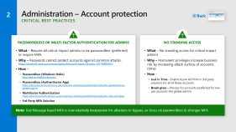
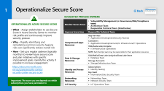
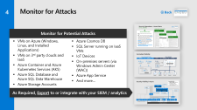
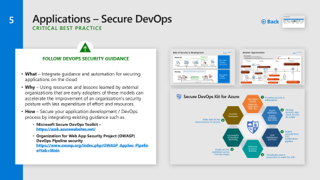
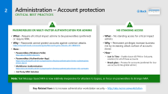
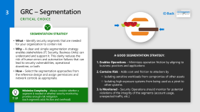

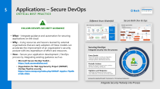
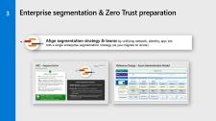
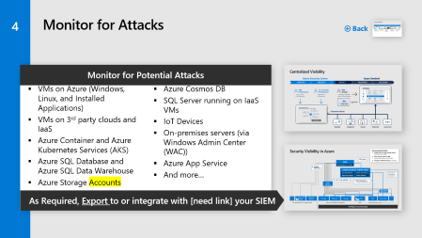
Best Practices 1 - 5
1
2
3
4
5
Operationalize Secure Score for cleaning up risk
Passwordless or MFA for admins
Enterprise segmentation & Zero Trust preparation
Enable Threat Protection for Azure Resources
Follow guidance to secure your DevOps

Slide 12
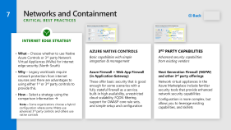
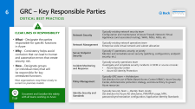
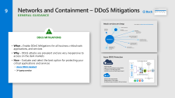
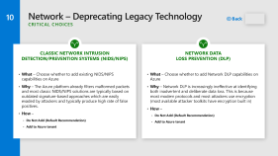
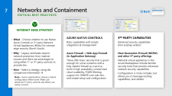
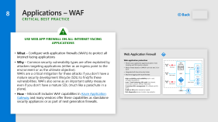


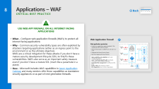

Best Practices 6 - 10
6
7
8
9
10
Assign and Publish Roles/ Responsibilities
Choose Firewall Strategy
Implement Web Application Firewalls
Choose DDoS Mitigation for Critical Apps
Consider Retiring Legacy/Classic Technology

Slide 13

Calls To Action
Follow Best Practices
in your Design → Build → Operations
Learn More
Videos aka.ms/AzureSecurityCompass-Videos
Download slides aka.ms/AzureSecurityCompass
Architecture Guidance aka.ms/AzureSecurityArchitecture
Share
Architecture → architects & technical teams
Slides → all of your teams
Provide Feedback
Compass - Security and Identity Forum in https://aka.ms/SecurityCommunity
Join Secure Score Private Preview https://aka.ms/MicrosoftSecurityPreviewProgram

Slide 14


Operationalize Secure Score
1
Back
Suggested Process Owners
Operationalize Azure Secure Score
What – Assign stakeholders to use Secure Score in Azure Security Center to monitor risk profile and continuously improve security posture
Why – Rapidly identifying and remediating common security hygiene risks can significantly reduce overall risk
How – Set up a regular cadence (typically monthly) to review Azure secure score and plan initiatives with specific improvement goals. Gamify the activity if possible to increase engagement.
https://docs.microsoft.com/ en-us/azure/security-center/ security-center-secure-score
Monitor Secure Score | Vulnerability Management (or Governance/Risk/Compliance team) Architecture Team Responsible Technical Team (listed below)
Improve Score Area | Responsible Technical Team
Compute and Apps Resources | App Services Application Development/Security Team(s) Containers Application Development and/or Infrastructure/IT Operations VMs/Scale sets/compute IT/Infrastructure Operations NOTE: Each DevOps team may be responsible for their application resources
Data & Storage Resources | SQL/Redis/Data Lake Analytics/Data Lake Store Database Team Storage Accounts Storage/Infrastructure Team
Identity and Access Resources | Subscriptions Identity Team(s) Key Vault Information/Data Security Team
Networking Resources | Networking Team Network Security Team
IoT Security | IoT Operations Team
Important: The score you see depends on which subscriptions you have permission to

Slide 15
Administration – Account protection Critical Best Practices
2
Back
Passwordless Or Multi-factor Authentication For Admins
What – Require all critical impact admins to be passwordless (preferred) or require MFA.
Why – Passwords cannot protect accounts against common attacks. https://channel9.msdn.com/events/Ignite/Microsoft-Ignite-Orlando-2017/BRK3016
How –
Passwordless (Windows Hello) http://aka.ms/HelloForBusiness
Passwordless (Authenticator App) https://docs.microsoft.com/en-us/azure/active-directory/authentication/howto-authentication-phone-sign-in
Multifactor Authentication https://docs.microsoft.com/en-us/azure/active-directory/authentication/howto-mfa-userstates
3rd Party MFA Solution
No Standing Access
What – No standing access for critical impact admins
Why – Permanent privileges increase business risk by increasing attack surface of accounts (time)
How –
Just in Time - Enable Azure AD PIM or 3rd party solution) for all of these accounts
Break glass – Process for accounts (preferred for low use accounts like global admin)
Note: Text Message based MFA is now relatively inexpensive for attackers to bypass, so focus on passwordless & stronger MFA
Key Related Item is to increase administrator workstation security – http://aka.ms/secureworkstation

Slide 16
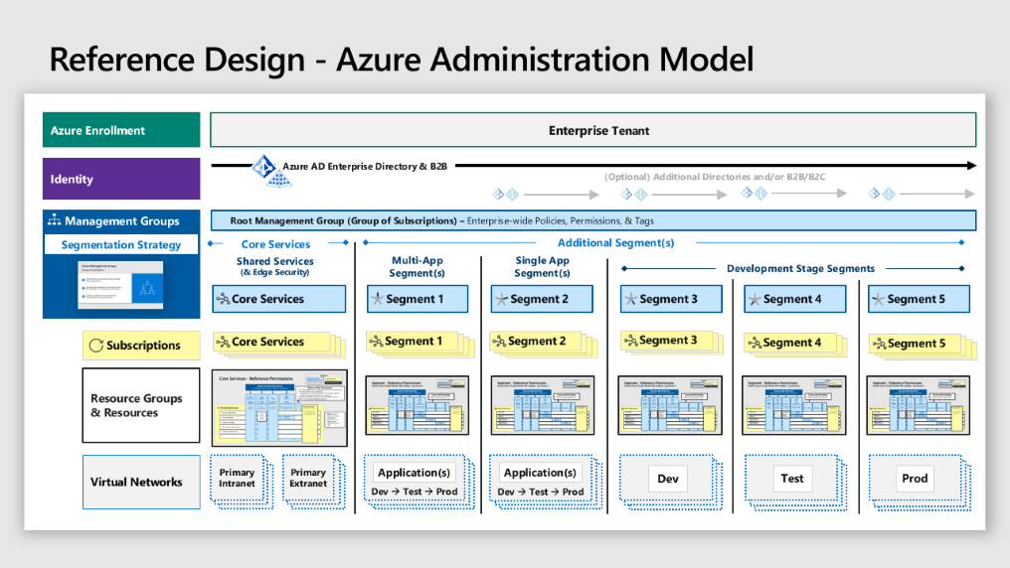
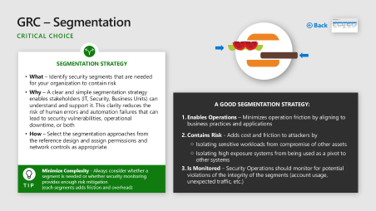
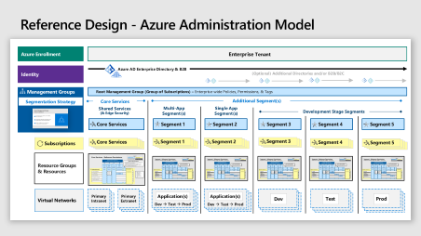

Enterprise segmentation & Zero Trust preparation
3
Align segmentation strategy & teams by unifying network, identity, app, etc. into a single enterprise segmentation strategy (as you migrate to Azure)

Slide 17

GRC – Segmentation
Back
Critical CHOICE
SEGMENTATION STRATEGY
What – Identify security segments that are needed for your organization to contain risk
Why – A clear and simple segmentation strategy enables stakeholders (IT, Security, Business Units) can understand and support it. This clarity reduces the risk of human errors and automation failures that can lead to security vulnerabilities, operational downtime, or both
How – Select the segmentation approaches from the reference design and assign permissions and network controls as appropriate.
A Good Segmentation Strategy:
Enables Operations – Minimizes operation friction by aligning to business practices and applications
Contains Risk - Adds cost and friction to attackers by
Isolating sensitive workloads from compromise of other assets
Isolating high exposure systems from being used as a pivot to other systems
Is Monitored – Security Operations should monitor for potential violations of the integrity of the segments (account usage, unexpected traffic, etc.)
Minimize Complexity - Always consider whether a segment is needed or whether security monitoring provides enough risk mitigation (each segments adds friction and overhead)
Tip

Slide 18



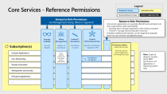






Reference Design - Azure Administration Model
Azure Enrollment
Enterprise Tenant
Identity
Azure AD Enterprise Directory & B2B
(Optional) Additional Directories and/or B2B/B2C
Management Groups
Root Management Group (Group of Subscriptions) – Enterprise-wide Policies, Permissions, & Tags
Segmentation Strategy
Core Services
Additional Segment(s)
Shared Services (& Edge Security)
Multi-App Segment(s)
Single App Segment(s)
Development Stage Segments
Core Services
Segment 1
Segment 2
Segment 3
Segment 4
Segment 5
Subscriptions
Core Services
Segment 1
Segment 2
Segment 3
Segment 4
Segment 5
Resource Groups & Resources
Virtual Networks
Primary
Intranet
Primary Extranet
Dev → Test → Prod
Dev → Test → Prod
Dev → Test → Prod
PaaS Apps
Application(s)
Application(s)
Dev → Test → Prod
Dev
Test
Prod
Notes:
Key Takeaway: This is a reference model you can use to start your design process or compare to your existing design.
This model leverages real world deployment experience and focuses on
Simplicity – to increase understandability of the design, which helps increase managing/monitoring effectiveness. Simplicity also increases reliability of automation
Central Visibility – to facilitate a consolidated view of potential risks by security organization(s)
Autonomy – to enable DevOps processes (by including permission assignments over the resources for an application in the segment reference permissions)
Flexibility - to meet the needs of the organization, including flexible segmentation models and a choice of centralized vs. federated administration permissions for each segment (e.g. options for different operations permissions models in the segment reference permissions).
The Enterprise-wide resources include the Enterprise Enrollment (frequently referred to as the Tenant), Enterprise Directory in Azure AD, and the Root Management Group.
We recommend using a single Azure Tenant, though we recognize that many customers may have currently have multiple tenants due to organic use of Azure that may need to be consolidated.
Valid reasons for creating a separate tenant are rare and would typically include strong separation requirements like a joint venture or other highly isolated business function.
Azure Active Directory (Azure AD) provides a unified identity for Azure, on premises resources (via Active Directory), 3rd party SaaS applications, PaaS Applications you develop, and more
CLICK 1
The segmentation model is set strategically at a high level (Management Groups) to ensure that all layers align to it. Most on-premises environment suffered from operational and security issues because segmentation approaches were separately designed and implemented by networking teams, application teams, and identity teams that all conflicted with each other and caused frequent conflicts (and security/firewall exceptions).
Core Services Segment - Most organizations have a set of common shared services that are used across the enterprise. Additional segments can be defined by the organization to meet their needs.
CLICK 2
All of the permissions assigned to the management group will be inherited by the subscriptions in it (a management group is effectively a group of subscriptions). This allows flexibility for a single subscription or multiple subscriptions in a segment (though we recommend limiting the number of subscriptions unless needed because each adds some management/configuration overhead.
CLICK 3
There are a number of different valid approaches to design the segmentation model depending on your organization’s structure, culture, industry, operational model, and other factors.
Most organizations will use one or more segments that fit these segment types
Multi-app segments aligned to a business unit, organizational function, risk profile (e.g. legacy applications) or other common attribute
Single application segments for applications with a unique risk or operational profile (high value/impact, high risk / legacy, etc. )
Development Stage segments for separating development, test, and production environments.
Setting the segmentation model at a top level helps to naturally aligns networks and applications into a unified approach. Ensuring all teams (including identity) are aligned to a single model increases the chances that the segmentation strategy will be effective against attackers.

Slide 19
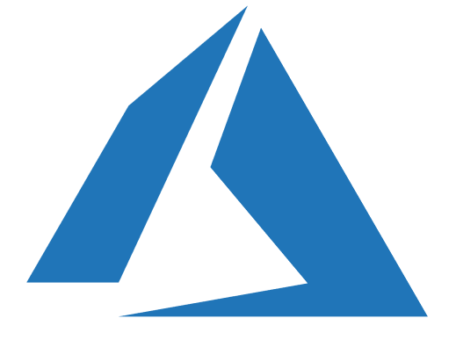







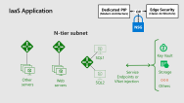

Reference Enterprise Design - Azure Network Security
Hybrid Cloud Infrastructure – Network Architecture
Microsoft Azure
3rd party IaaS
On Premises Datacenter(s)
Core Services
Additional Segment(s)
Shared Services Segment
Segment(s)
Development Stage Segments
Edge Security
Organization
Public IP
Dev
DDoS Mitigation
Extranet Applications
Extranet
Load Balancer (Optional)
Firewall
NSG
NSG
NSG
ExpressRoute Gateway
Gateway subnet
NSG
Test
ExpressRoute
VNET PEERING
Domain Controllers
Management & Security
Legend
Application
NSG
NSG
Subscription
Intranet
Enterprise Applications
Others as needed
Prod
Virtual Network
Subnet
NSG
NSG
NSG
Network Security Group
Hub – Shared Service Virtual Network
Spoke(s) - Aligned to Segment Model
Notes:
Key Takeaway: This is a reference enterprise network design that depicts a core services segment and several example segments aligned to the segmentation model presented earlier
Notes on this diagram
The network edge security in the core services segment can use either native controls or virtual appliances
The shared services in the core services segment may be hosted in a single VNET or can span across multiple VNETs (e.g. for intranet vs. extranet resources)
The core services segment includes examples of groupings we typically see in most enterprises
Each of the segments is connected to each other by VNET peering configurations
A public IP address may be mapped to an application within a segment that may not route through the network edge (depicted if you zoom into example applications). This activity can be restricted with permissions and/or routing.

Slide 20

Azure Management Groups
Groups of subscriptions
Set permissions and policies across multiple Azure subscriptions
Set enterprise permissions and policies across all subscriptions in the tenant (enrollment)
Enables compliance and cost reporting by organizations (business/teams)

Slide 21





Core Services - Reference Permissions
Legend
Management Groups
Subscription Roles
Resources/Resource Groups
Custom / Application Roles
Enterprise Role Permissions
via Management Group (Root or Segment)
Resource Role Permissions
Core service applications are typically lift/shift IaaS workloads and most organizations split responsibility
Specialty team manages application with existing console(s)
Central IT manage Azure production resources.
If needed, additional permissions can be assigned to specialty teams via core services management group.
Security Visibility
Security Readers
Policy Management
Reader → Contributor
Central IT Operations
Contributor or Owner
Central Networking Group
Network Contributors + Appliance VMs
…
Subscription(s)
Service Admin (Break Glass Access)
Primarily used for initial configuration and emergency access
Extranet Applications
Policy typically matures over time from audit to enforcement
Note: Scope of diagram includes Azure RBAC permissions, not Application or Operating System roles
Core Networking
Contributor or Owner
Domain Controllers
Management and Security
Enterprise Applications
…
Notes:
Key Takeaway: This is a reference permission model for core services (shared services) you can use to start your design process or compare to your design.

Slide 22
Segment - Reference Permissions Autonomous DevOps Model with visibility + governance
Legend
Management Groups
Subscription Roles
Resources/Resource Groups
Custom / Application Roles
Enterprise Role Permissions
via Management Group (Root or Segment)
Resource Role Permissions
Assigned via segment management group to support Autonomous DevOps model
Security Visibility
Security Readers
Policy Management
Reader → Contributor
IT Operations
Contributor or Owner
Central Networking Group
Network Contributors + Appliance VMs
App1 Admins
App2 Admins
…
Subscription(s)
Service Admin (Break Glass Access)
Primarily used for initial configuration and emergency access
Policy typically matures over time from audit to enforcement
Segment Model Variations
Central IT
Businesss Unit IT
None (app admins only)
Networking
Contributor or Owner
Contributor or Owner (Optional)
Network Security Resources (Optional)
Contributor or Owner
App1 Resources (VMs, Storage, etc.)
Contributor or Owner
App2 Resources (VMs, Storage, etc.)
…
Notes:
Key Takeaway: This is a reference permission model for a segment that you can use to start your design process or compare to your design.

Slide 23
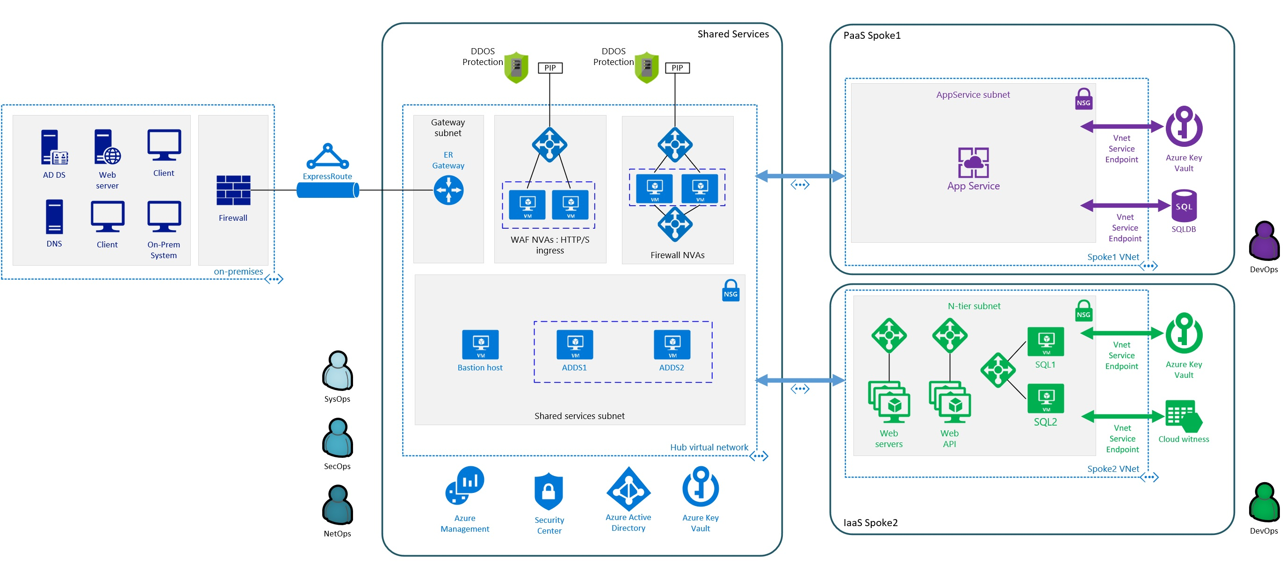
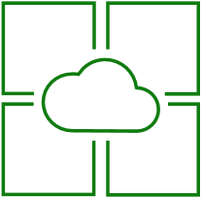
PaaS Application
Dedicated PIP (Modern Architecture)
Edge Security
(Classic Architecture)
OR
NSG
Other Services
AppService Subnet
Some services cannot be deployed to virtual networks
Other Public Cloud Providers
Azure Services not yet enabled for Service Endpoints (Service Tunnel) or VNet Service Injections
Key Vault
Service Endpoints or VNet injection
Storage
App Service
Others
Notes:
Key Takeaway: This is a generic network diagram of a Platform as a Service (PaaS) application
Internet Ingress/Egress traffic for the application can be routed via the network edge security stack or via a Public IP (PIP) assigned to the application.
The application can access services via the Azure network or directly into the subnet with a Service Endpoint (Service Tunnel) or VNet injection (if available for the service)
The App Service here could be a simple App Service instance or a full App Service Environment (ASE). In addition to manageability/scalability, an ASE offers security benefits in the form of centralized network control (for supported services) and centralized visibility from NSG flow logs and/or virtual network appliances. For more information on ASEs, see https://docs.microsoft.com/en-us/azure/app-service/environment/intro

Slide 24
IaaS Application
Dedicated PIP (Modern Architecture)
Edge Security
(Classic Architecture)
OR
NSG
N-tier subnet
Key Vault
SQL1
Service Endpoints or VNet injection
Storage
Other servers
Web servers
SQL2
Others
Notes:
Key Takeaway: This is a generic network diagram of an IaaS application
Internet Ingress/Egress traffic for the application can be routed via the network edge security stack or via a Public IP (PIP) assigned to the application.
The application can access services via the Azure network or directly into the subnet with a Service Endpoint (Service Tunnel) or VNet injection (if available for the service)

Slide 25
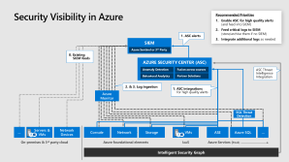
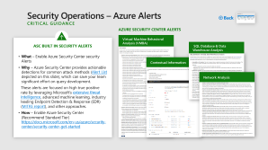
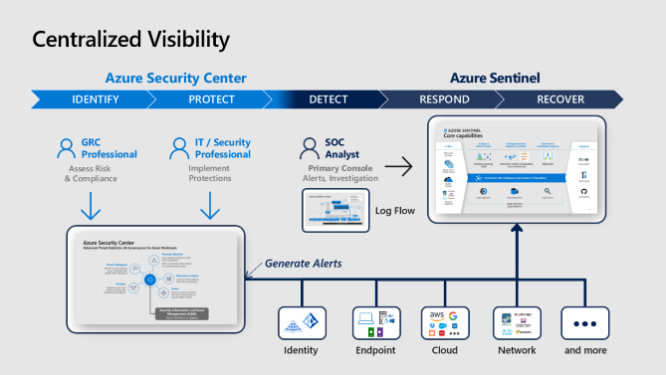
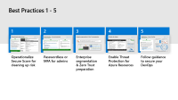

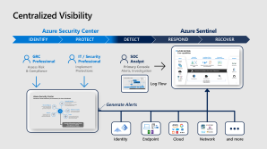

Monitor for Attacks
4
Back
Monitor for Potential Attacks
VMs on Azure (Windows, Linux, and Installed Applications)
VMs on 3rd party clouds and IaaS
Azure Container and Azure Kubernetes Services (AKS)
Azure SQL Database and Azure SQL Data Warehouse
Azure Storage Accounts
Azure Cosmos DB
SQL Server running on IaaS VMs
IoT Devices
On-premises servers (via Windows Admin Center (WAC))
Azure App Service
And more…
As Required, Export to or integrate with your SIEM / analytics

Slide 26




Security Operations – Azure Alerts Critical GUIDANCE
Back
Azure Security Center Alerts
ASC BUILT IN Security Alerts
What – Enable Azure Security Center security Alerts
Why – Azure Security Center provides actionable detections for common attack methods (Alert List depicted on this slide), which can save your team significant effort on query development.
These alerts are focused on high true positive rate by leveraging Microsoft’s extensive threat intelligence, advanced machine learning, industry leading Endpoint Detection & Response (EDR) (MITRE report), and other approaches.
How – Enable Azure Security Center (Recommend Standard Tier) https://docs.microsoft.com/en-us/azure/security-center/security-center-get-started
Virtual Machine Behavioral Analysis (VMBA)
SQL Database & Data Warehouse Analysis​
Contextual Information
Network Analysis

Slide 27
















Centralized Visibility
Azure Security Center
Azure Sentinel
IDENTIFY
RESPOND
RECOVER
DETECT
PROTECT
GRC Professional
IT / Security Professional
SOC Analyst
Assess Risk & Compliance
Implement Protections
Primary Console
Alerts, Investigation
Log Flow
Generate Alerts
Identity
Endpoint
Cloud
Network
and more
Notes:
Key Takeaway: Azure Security Center and Azure Sentinel are different capabilities with complementary purposes
Azure Security Center is focused on protection and governance of Azure Workloads by assessing risk to them, reducing attack surface, and generating alerts on potential threats using advanced threat detection technologies. The roles who use ASC will typically include security engineers and GRC Professionals that report risk to the CISO.
Azure Sentinel is focused on monitoring All Environments by SOC analysts. Azure Sentinel allows for monitoring alerts and security related events from any source (Microsoft security solutions, 3rd party, costume rules). Azure Sentinel is built for security analysts and SOC managers to make their work easier and more effective. Azure Sentinel is designed to simplify the application of advanced technologies like Machine Learning, User and Entity Behavior Analytics (UEBA), to the variety of datasets you monitor and is complemented by other Microsoft Threat Protection solutions that provide specialized investigation of hosts, email, identity attacks, and more.

Slide 28
Security Visibility in Azure
Recommended Priorities
Enable ASC for high quality alerts (and feed into SIEM)
Feed critical logs to SIEM (store/archive them if no SIEM)
Integrate additional logs as needed
1. ASC alerts
SIEM
Azure Sentinel or 3rd Party
0. Existing
SIEM feeds
AZURE SECURITY CENTER (ASC)
Anomaly Detection
Fusion across sources
ASC Threat Intelligence Integration
Behavioral Analytics
Partner Solutions
2. & 3. Log ingestion
1. ASC integrations for high quality alerts
Azure Monitor
SQL Threat Detection
…
Servers & VMs
Network Devices
Console
Network
Storage
VMs
ASE
Azure SQL
…
On-premises & 3rd party cloud
Azure foundational elements
IaaS
Azure Services (PaaS)
Intelligent Security Graph
Notes:
Key Takeaway: This diagram provides a conceptual overview of the flow of security logs and alerts

Slide 29

Azure Security Center Advanced Threat Detection (& Governance) for Azure Workloads
Anomaly detection
Uses statistical profiling to build historical baselines
Alerts on deviations that conform to a potential attack vector
Threat intelligence
Looks for known malicious actors using Microsoft global threat intelligence
Behavioral analytics
Looks for known patterns and malicious behaviors
Partners
Integrates alerts from partner solutions, like firewall and antimalware
Fusion
Combines events and alerts from across the kill chain to map the attack timeline
Security Information and Event Management (SIEM)
Azure Sentinel or Legacy
Notes:
Key Takeaway: Azure Security Center (standard) includes detection of attacks on Azure hosted resources using these approaches:
Log based alerts from ASC log analytics
Endpoint Detection and Response integration from Windows Defender ATP
Advanced detections such as Machine Learning (ML) applied to crashdumps, fileless detections using memory analysists on Azure VMs, behavioral analytics, ML based anomaly detection for network traffic, etc.
Threat Intelligence from Microsoft’s intelligent security graph
SQL attack detection like SQL injection (SQLi) attack detection and anomalous behavior detection

Slide 30












Core capabilities
Cloud Native SIEM + SOAR - Azure Sentinel
AZURE SENTINEL
Analyze & detect threats
Investigate & hunt suspicious activities
Automate & orchestrate response
Collect
Integrate
Microsoft Services
Machine learning, UEBA
Interactive Attack Visualization, Azure Notebooks
Playbooks
ServiceNow
Apps, users, infrastructure
Enrichment with Intelligence (Geo location, IP Reputation)
Public Clouds
Other tools
Data Ingestion
Data Repository
Data Search
Community
Security solutions
Azure Monitor (log analytics)
Notes:
Key Takeaway: Azure Sentinel is a Cloud-native SIEM solution that includes Security Orchestration, Automation and Response (SOAR), Machine Learning, and Behavior Analytics
Like legacy SIEMs, Azure Sentinel can collect, store, and analyze security data of nearly any format and source. Because it is built on native cloud services, Azure Sentinel can store and analyze immense amounts of logs without requiring on-premises infrastructure like servers, storage and networking. Additionally, the cloud architecture allows Azure Sentinel to reason over millions of records within seconds.
CLICK 1
Azure Sentinel leverages Microsoft’s threat intelligence system (called the Intelligent Security Graph) that processes 6.5 trillion signals per day from a diverse set of sources (endpoint, web, network, malware, and more). Azure sentinel integrates the resulting geo location and IP reputation feeds to enrich your alerts and investigations.
CLICK 2
Analyze and Detect Threats - Azure Sentinel simplifies the use of advanced analytics technology like machine learning and behavior analytics to enable analysts to rapidly identify and investigate anomalies.
As an example, the machine learning in azure sentinel can quickly identify a spike in events on a particular Saturday (relative to other Saturdays) and then automatically generate a query to return the logs during that timeframe so the analyst can begin investigating whether it is an active attack or a benign event.
Investigate and Hunt Suspicious activities - Azure sentinel includes an interactive visualization of attacks so you can quickly and intuitively navigate the related elements of an attack to understand its scope, dive deep, and pivot without typing a query.
Azure Sentinel also supports Jupyter notebooks via Azure notebooks to enable your team to consume operations playbooks and methodology from the community as well as create and update your own.
CLICK 3
Additionally, Azure Sentinel automates and orchestrates response across tools in your enterprise like ServiceNow, Slack/Teams/Email, and Security tools like Palo Alto Firewalls.
Azure Sentinel is built with a connection to the community on GitHub and allows you to leverage resources from the community including detections, dashboards, functions, notebooks, playbooks, hunting queries and more. You can also contribute your own learnings to the community for other teams to use.

Slide 31






Applications – Secure DevOps Critical Best Practice
5
Back
Different than Waterfall
Secure Both Dev & Ops
Follow DevOps security guidance
What – Integrate guidance and automation for securing applications on the cloud
Why – Using resources and lessons learned by external organizations that are early adopters of these models can accelerate the improvement of an organization’s security posture with less expenditure of effort and resources.
How – Secure your application development / DevOps process by integrating existing guidance such as
Microsoft Secure DevOps Toolkit – https://azsk.azurewebsites.net/
Organization for Web App Security Project (OWASP) DevOps Pipeline security https://www.owasp.org/index.php/OWASP_AppSec_Pipeline#tab=Main
Integrate Security Natively into Process

Slide 32




Attacker Opportunities
Back
Attacker Pivot Risks
Secondary attacks using compromised artifacts/access
Lateral Movement – Pass the hash/ticket/password/etc.
Development Artifacts – Stolen keys/credentials, implanted malware or backdoors, etc.
Legend
Developer-based attacks
IT and Operations-based attacks
Planning
Coding
Testing
Production
Production App Vulnerability
Vuln Discovered in App or a Re-used Component
Public
repository
Coding Vulnerability Introduce exploitable vulns
Supply Chain Vuln/Implant
Vulnerable Code added to Application
Writing New Code
Design Vulnerability
Design Choices create Security Issues
Re-use components
Web/Email Risk
On Dev workstation
Corporate
repository
Build automation
Version
release
Upload to Repository
Development Infrastructure
Infrastructure Security Risks
Repository Access
Weak Authentication/Authorization
Tester Workstation
Developer team
Application code
Developer Workstation
Production Infra Vulnerability
Vulnerability in infrastructure hosting App (on-prem, Azure, AWS, etc.)
Credential Attacks
Weak passwords/authentication
Dev Workstation Security
Infrastructure Security Risks

Slide 33



Role of Security in Development
Back
Bias to Plan
& Quality
(Weeks/Months)
Waterfall
Full lifecycle security ideal but rare
Planning
Coding
Testing
Typically security is a quality gate in release
Production
Feedback Loop
Bias to Speed & Agility
(Hours/Days)
DevOps
Quality and Security risk mitigated by rapidly release of fixes
Embedding security expertise and dynamic + static testing in process required for success
Planning / Coding
Testing / Production
Feedback Loop

Slide 34
Securing DevOps: Integrate security into the process
Governance – Continuous Improvement
Operate
Every Sprint Reduce risk natively in Continuous Integration / Continuous Delivery (CI/CD) with real-time developer guidance, build checks, and more
Plan
Deliver
Develop
Periodic Actions Regular risk reduction and governance activities like Threat modelling, Training, etc.
Developer
Vigilance and Response Monitoring and Response processes to ensure close collaboration of Security and DevOps teams
Learnings from migrating Microsoft’s IT environment to ~95% cloud-based infrastructure

Slide 35


GRC – Key Responsible Parties
6
Back
Critical Best Practices
Clear Lines of Responsibility
What – Designate the parties responsible for specific functions in Azure
Why – Consistency helps avoid confusion that can lead to human and automation errors that create security risk.
How – Designate groups (or individual roles) that will be responsible for key centralized functions
Most organizations map these closely to current on premises models.
Network Security | Typically existing network security team Configuration and maintenance of Azure Firewall, Network Virtual Appliances (and associated routing), WAFs, NSGs, ASGs, etc.
Network Management | Typically existing network operations team Enterprise-wide virtual network and subnet allocation
Server Endpoint Security | Typically IT operations, security, or jointly Monitor and remediate server security (patching, configuration, endpoint security, etc.)
Incident Monitoring and Response | Typically security operations team Investigate and remediate security incidents in SIEM or source console: Azure Security Center Azure AD Identity Protection
Policy Management | Typically GRC team + Architecture Set direction for use of Roles Based Access Control (RBAC), Azure Security Center, Administrator protection strategy, and Azure Policy to govern Azure resources
Identity Security and Standards | Typically Security Team + Identity Team Jointly Set direction for Azure AD directories, PIM/PAM usage, MFA, password/synchronization configuration, Application Identity Standards
Document and Socialize this widely with all teams working on Azure
Tip

Slide 36




Networks and Containment Critical Best Practices
7
Back
Internet EDGE STRATEGY
What – Choose whether to use Native Azure Controls or 3rd party Network Virtual Appliances (NVAs) for internet edge security (North-South)
Why – Legacy workloads require network protection from internet sources and there are advantages to using either 1st or 3rd party controls to provide this.
How – Select a strategy using the comparison information →
Note – Some organizations choose a hybrid configuration where some VNets use advanced 3rd party controls and others use native controls
AZURE NATIVE CONTROLS
Basic capabilities with simple integration & management
Azure Firewall + Web App Firewall (in Application Gateway)
These offer basic security that is good enough for some scenarios with a fully stateful firewall as a service, built-in high availability, unrestricted cloud scalability, FQDN filtering, support for OWASP core rule sets, and simple setup and configuration
3rd Party Capabilities
Advanced security capabilities from existing vendors
Next Generation Firewall (NGFW) and other 3rd party offerings
Network virtual appliances in the Azure Marketplace include familiar security tools that provide enhanced network security capabilities
Configuration is more complex, but allows you to leverage existing capabilities, and skillets
Notes:
Key Takeaway: For your core services segment (and optionally for each segment), you can choose between native controls and 3rd party capabilities for internet traffic filtering

Slide 37







Reference Configuration with Native Controls
Azure Firewall + Application Gateway with Web App Firewall (WAF)
Core Services
Core Services Subscription
Azure Firewall
Public IP
1
2
Firewall Subnet
Virtual Network
Internet
NSG
DDoS Protection
Subnet
Public IP
Web Application Firewall
NSG
Gateway Subnet
On Premises Network(s)
ExpressRoute Gateway
ExpressRoute
Network Security Group (NSG)
NSG
NSG
Subnet
Subnet
6
Notes:
Key Takeaway: This is a depiction of a core services segment using native Azure controls (depicted within a single subscription)
More Information
The Azure Firewall and WAF (in Application gateway) are designed natively with high availability and don’t require you to configure load balancers
WAFs functionality is depicted here with a public IPs, but they can also use private IPs in your virtual network as a frontend as well.

Slide 38


Azure Firewall
Cloud native stateful Firewall as a service
L3-L7 Connectivity Policies
A first among public cloud providers
Spoke 1
Microsoft Threat Intelligence Known malicious IPS and FQDNs
Central governance of all traffic flows
Built-in high availability and auto scale
Network and application traffic filtering
Centralized policy across VNets and subscriptions
Complete VNET protection
Filter Outbound, Inbound, Spoke-Spoke & Hybrid Connections traffic (VPN and ExpressRoute)
Threat intelligence-based filtering to alert/deny traffic from/to known malicious IP addresses and domains.
Centralized logging
Archive logs to a storage account, stream events to your Event Hub, or send them to Log Analytics or Security Integration and Event Management (SIEM) system of choice
NAT, Network and Application traffic filtering rules allows Inbound/Outbound access
Central VNet
Spoke2
Azure Firewall
Spoke VNets
Azure to On-Prem traffic filtering
Traffic is denied by default
On-Premises
https://docs.microsoft.com/en-us/azure/firewall/

Slide 39

Web Application Firewall
Web application protection
Protects your application against prevalent X-Site Scripting and SQL Injection attacks
Blocks threats based on OWASP core rule sets 3.0 or 2.2.9
Integrated with Azure Security Center
Real-time logging with Azure Monitor
App Gateway
Site 1
XSS attack
Valid request
WAF
Valid request
Site 2
High availability and scalability built in and managed by platform
Layer 7 load balancing URL path, host based, round robin, session affinity, redirection
Centralized SSL management SSL offload and SSL policy
Public or ILB public internal or hybrid
Rich diagnostics Azure monitor, Log analytics
Valid request
SQL injection
L7 LB
VPN
On-Premises
Notes:
More Information at https://docs.microsoft.com/en-us/azure/application-gateway/waf-overview

Slide 40





Reference Configuration with Virtual Appliance(s)
Next Generation Firewall with Integrated WAF/Proxy
Core Services
Core Services Subscription
Popular Next Generation Firewalls available in Azure Marketplace
Load balancer enables scalability and availability
DDoS Protection Standard can be applied to public IP addresses.
More Information online
https://docs.microsoft.com/en-us/azure/architecture/reference-architectures/hybrid-networking/shared-services
1
2
Public IP
Virtual Network
Internet
DMZ outside
N I C
NVA
N I C
DMZ inside
NSG
Subnet
DDoS Protection
Availability set
Load balancer
N I C
NVA
N I C
NSG
NSG
NSG
Gateway Subnet
On Premises Network(s)
ExpressRoute Gateway
ExpressRoute
Network Security Group (NSG)
NSG
NSG
Subnet
Subnet
6
Notes:
Key Takeaway: This is a depiction of a core services segment using a Next Generation Firewall (NGFWs) with built in WAF capabilities
Enterprise customers frequently choose this configuration to utilize their existing licensing and skillsets in Azure
Note that these are instantiated as VMs running the appliance (not a service like the native capabilities), so you need to configure the appropriate subnets, routing, network virtual applications (NVAs), and load balancers for a resilient architecture

Slide 41


Applications – WAF Critical BEST PRACTICE
8
Back
Use Web App Firewall on All Internet Facing Applications
What – Configure web application firewalls (WAFs) to protect all internet facing applications
Why – Common security vulnerability types are often exploited by attackers targeting applications (either as an ingress point to the environment or as the ultimate objective). WAFs are a critical mitigation for these attacks if you don’t have a mature security development lifecycle (SDL) to find/fix these vulnerabilities. WAFs also serve as an important safety measure even if you don’t have a mature SDL (much like a parachute in a plane).
How – Microsoft includes WAF capabilities in Azure Application Gateway and many vendors offer these capabilities as standalone security appliances or as part of next generation firewalls.

Slide 42




Networks and Containment – DDoS Mitigations General Guidance
9
Back
DDoS Mitigations
What – Enable DDoS Mitigations for all business-critical web applications, and services
Why – DDoS attacks are prevalent and are very inexpensive to access on the dark markets
How – Evaluate and select the best option for protecting your critical applications and services
Azure DDoS standard
3rd party service

Slide 43







Azure DDOS Protection
L3-L4 DDoS mitigation policies tuned to your application’s traffic profile
Standard
Spoke 1
Application performance and availability is guaranteed
Tuned to your apps
Logging, alerting and telemetry via Azure Monitor
L7 Protection via Web App Firewall (WAF)
Availability Guarantee and Rapid Response Support
Central VNet
Spoke2
Basic
Azure DDoS Protection Standard
Always on L3/L4 attack protection
Deployed today in all Azure regions
No additional charge and available to all Azure Customers
Spoke VNets
Blocks malicious traffic from internet
Notes:
Key Takeaway: Azure includes basic Distributed Denial of Service (DDoS) protection, which can be upgraded to the Standard offering
The basic capabilities apply to all workloads in Azure as this protection is applied to all Microsoft properties on our network (which also include services like Office 365, Windows Update, Xbox Live, etc.)
The standard offering adds local visibility and control for your workloads with
Advanced protection for your virtual network resources
Automatic mitigation for 60+ network layer attacks
Adaptive tuning via application traffic profiling and machine learning algorithm
Real time monitoring and alerting in Azure Monitor
Integration with WAF application layer protection
Note that resilience against some application-aware attacks also requires application architecture that can scale out (more VMs) vs. scaling up (bigger VMs).
More information on Microsoft’s DDoS Mitigation Capabilities
Global distribution of attack traffic during large scale attacks​
25+ Terabit-per-second (Tbps) global mitigation capacity
Continuously profiles normal Public IP traffic
https://docs.microsoft.com/en-us/azure/virtual-network/ddos-protection-overview

Slide 44
Network – Deprecating Legacy Technology Critical CHOICES
10
Back
Classic Network Intrusion Detection/Prevention Systems (NIDS/NIPS)
What – Choose whether to add existing NIDS/NIPS capabilities on Azure
Why – The Azure platform already filters malformed packets and most classic NIDS/NIPS solutions are typically based on outdated signature-based approaches which are easily evaded by attackers and typically produce high rate of false positives.
How –
Do Not Add (Default Recommendation)
Add to Azure tenant
Network Data Loss Prevention (DLP)
What – Choose whether to add Network DLP capabilities on Azure
Why – Network DLP is increasingly ineffective at identifying both inadvertent and deliberate data loss. This is because most modern protocols and most attackers use encryption (most available attacker toolkits have encryption built in)
How –
Do Not Add (Default Recommendation)
Add to Azure tenant
Notes:
Key Takeaway: You may want to deprecate and then discontinue some legacy security approaches as you move to Azure.
You can continue to use these technologies in Azure if you see value, but many organizations are not migrating these solutions to Azure, so these choices are explicitly surfaced.

Slide 45
Thank you!

